Slide 1


Age Estimate of Martian Dunes Based on a Possible Impact Feature
Sam Coleman
Northern Arizona University
USGS-Flagstaff
Mentor: Dr. Rosalyn Hayward

Slide 2
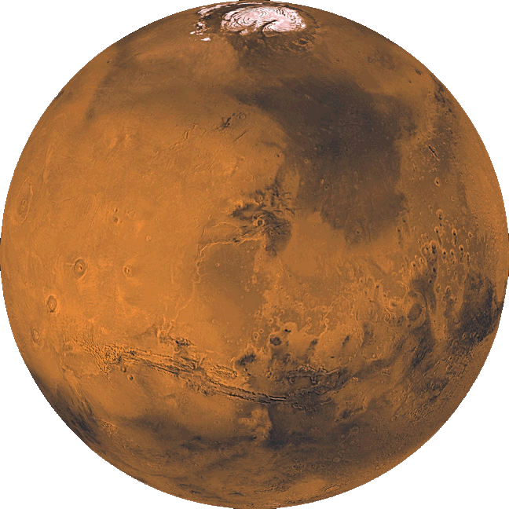
Outline
Introduction
Methods
Results
Conclusions
Future Work

Slide 3
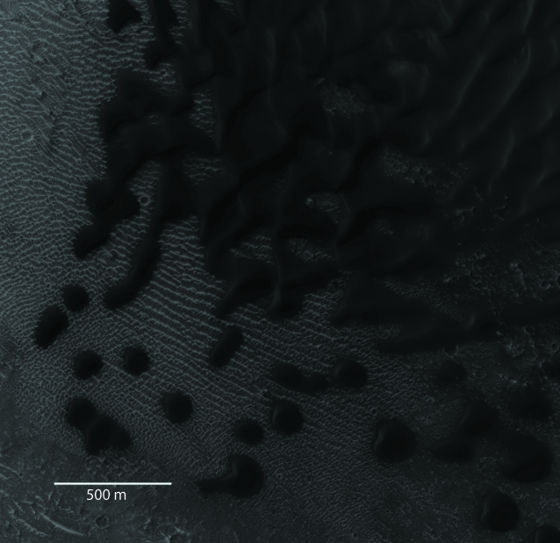
Introduction
Lack of age data for dunes
Age for Transverse Aeolian Ridges (TARs)
  0.621 Ma
  Older features
Until now, no craters on Mars dunes
HiRISE img# PSP_008159_1885_RED

Slide 4
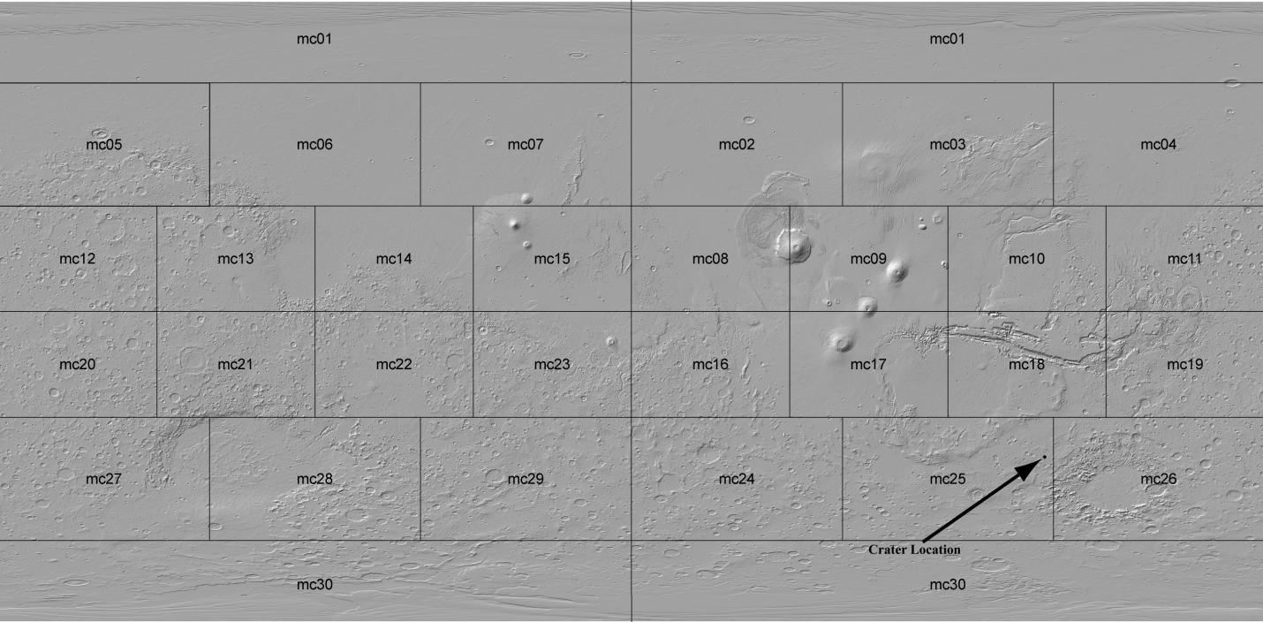
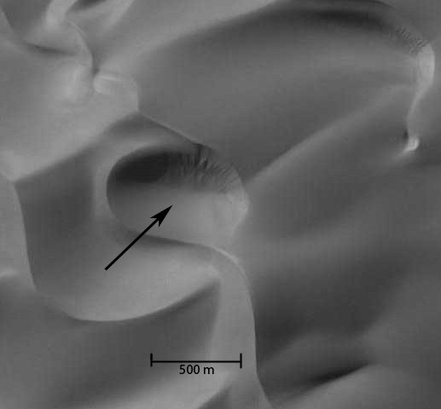
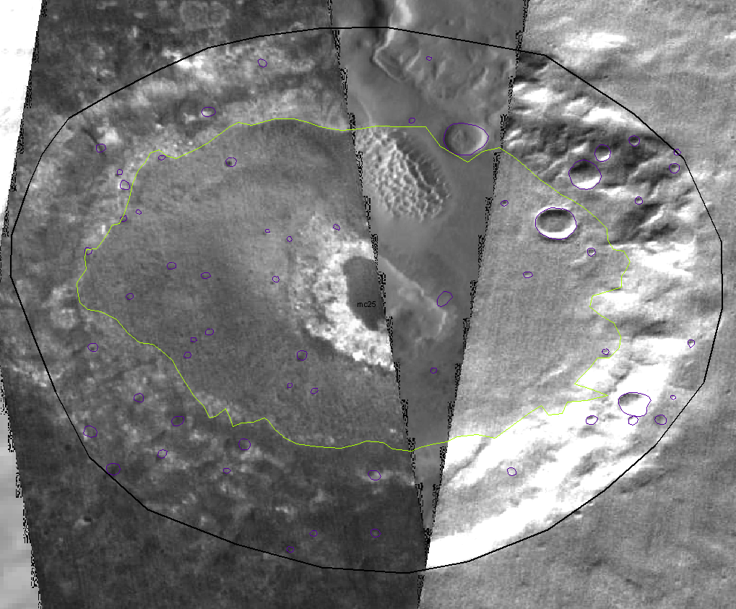
Shaded relief map from Mars Global Digital Dune Database
Mars Orbital Camera (MOC) img # r0301175

Slide 5
Feature Origin Analysis
Feature Origin | Pros | Cons
Volcanic | Appears to be a depression, round (like a volcanic crater) | In a dune field and has no surrounding lava (not a vent), no evidence for nearby eruption which could have produced volcanic bombs
Aeolian | In a dune field (already aeolian environment), sides are clearly formed of wind-blown sand, some nearby features bear a passing resemblance | Clear break in eastern crest, no other crests in the field have the same level of sinuosity as the western crest (possible outside influence)
Slump | Break in crest on the eastern rim, floor is filled in | Fill appears to be coming from the south, western rim
Impact | Depression, break in crest on eastern rim, western rim likely influenced by an underlying feature | No associated nearby impact structures, western rim is a clearly aeolian structure

Slide 6
Dating Methods
Perform crater count for dune field host crater
  Count craters and sort by diameter
  plot on curve vs. area
  Age constraint
3 different plots using the dune field crater
  Area of the dune field
  Area of dune fields with similar preservation
  Area of all Martian dune fields

Slide 7
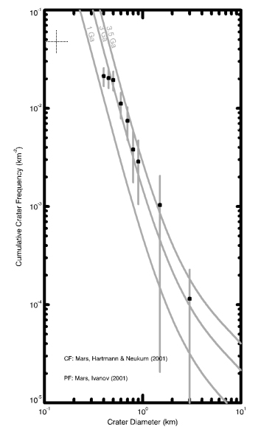
Age of host crater (~3.2 Ga)
Thermal Emission Imaging System (THEMIS) composite image of the host crater (from Mars Global digital Dune Database)

Slide 8
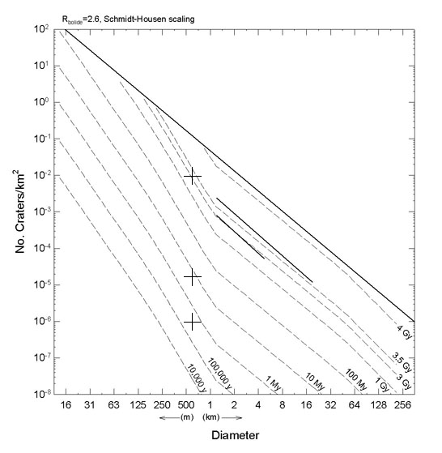
a: Age obtained using only the area of the dune field containing the crater (~3.2 Ga)
b: Age obtained using the are of dune fields with similar levels of preservation (~9Ma)
c: Age obtained using all dune fields on Mars (~0.300-0.500 Ma)
b
a
c

Slide 9
Conclusions
3.2 Ga age is wrong
  Same age as host crater
9 Ma age is wrong
  Much older than the TARs
0.500 Ma age is probably closest
  Methodology suspect
  Method that got the 9 Ma age is probably best

Slide 10
Future Development
High Resolution Imaging Science Experiment (HiRISE) imagery
  Help determine whether it really is a crater
  Study erosional features on North rim
Further study on impacts into sand
  What would crater look like?
  How fast would it erode?
Look for more craters on dunes
  More accurate age calculations

Slide 11
Acknowledgements
USGS - Flagstaff Astrogeology Science Center
Dr. Rosalyn Hayward, Dr. Tim Titus, Dr. Nadine Barlow
NASA Space Grant

Slide 12
Any Questions?

